Slide 1

IOT 4312
WIRELESS COMMUNICATIONS FOR IOT LAB
Project
Presentation

Slide 2
‘ChatHouse‘
An IOT-Based Smart Home Appliances controlling system via WhatsApp.
Presented By :
Rakib Hasan(1801047)
Md. Sakibul Alam Sakib(2001032)
Fardin Ahmed Ashan(2001033)

Slide 3
1
OVERVIEW
Introduction
Software Implementation
Objectives
Hardware Implementation
System Components
Final Outcome
Challenges & Limitations
Future Work
Refferences
Conclusion
Project Description
Flow Diagram
Expected Outcome

Slide 4
2
INTRODUCTION
Home automation systems have become increasingly popular, allowing users to control various household appliances such as lights, fans, and other electrical devices remotely. This project will focus on creating a low-cost, efficient, and user-friendly home automation system that leverages the power of IoT (Internet of Things) and WhatsApp messaging for remote control.

Slide 5
3
OBJECTIVES
To design and implement a home automation system.
To allow users to control home appliances remotely.
To integrate the WhatsApp messaging platform (e.g. twilio) to send and receive control commands for the home automation system.

Slide 6
4
SYSTEM COMPONENTS
HARDWARE
SOFTWARE
ESP32 microcontroller
Relay Module for appliance control
Bread Board
Connecting Wires, Home Appliances(Fan, light, water pump)
Arduino IDE
ThingESP
Twilio
WhatsApp

Slide 7
5
PROJECT DESCRIPTION
1
The system allows control of home appliances via WhatsApp messages using the ESP32 microcontroller.
2
When a command is sent, it is processed through the WhatsApp API (e.g., Twilio), and the ESP32 activates the appropriate relay to switch the appliance on or off.
3
The system also provides real-time feedback, confirming the appliance’s status to the user.

Slide 8
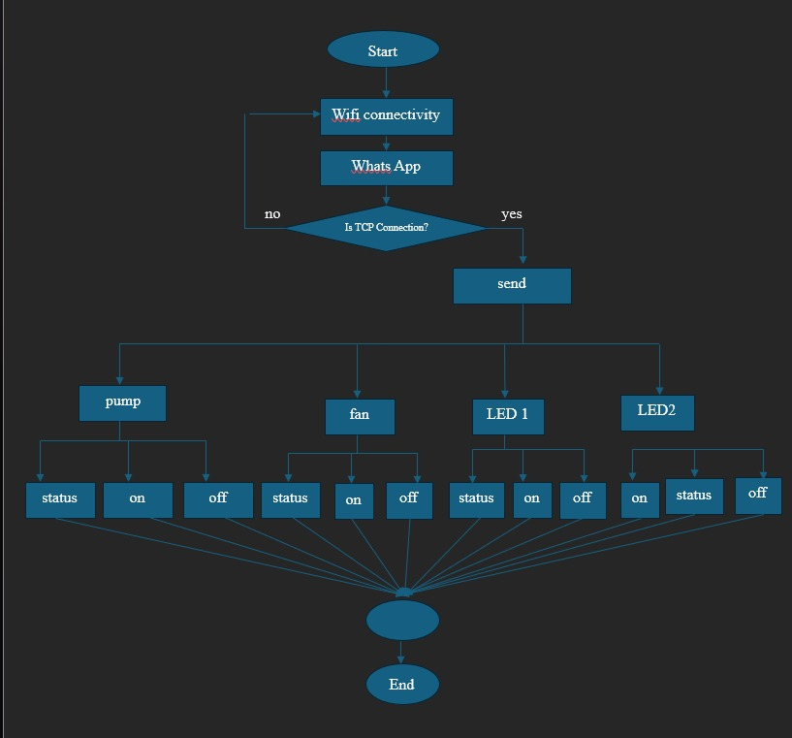
6
Flow Diagram

Slide 9
7
EXPECTED OUTCOME
1
Remotely control of home appliances via WhatsApp messages
2
Real-time status updates on appliance actions
3
Scalability for controlling multiple appliances

Slide 10
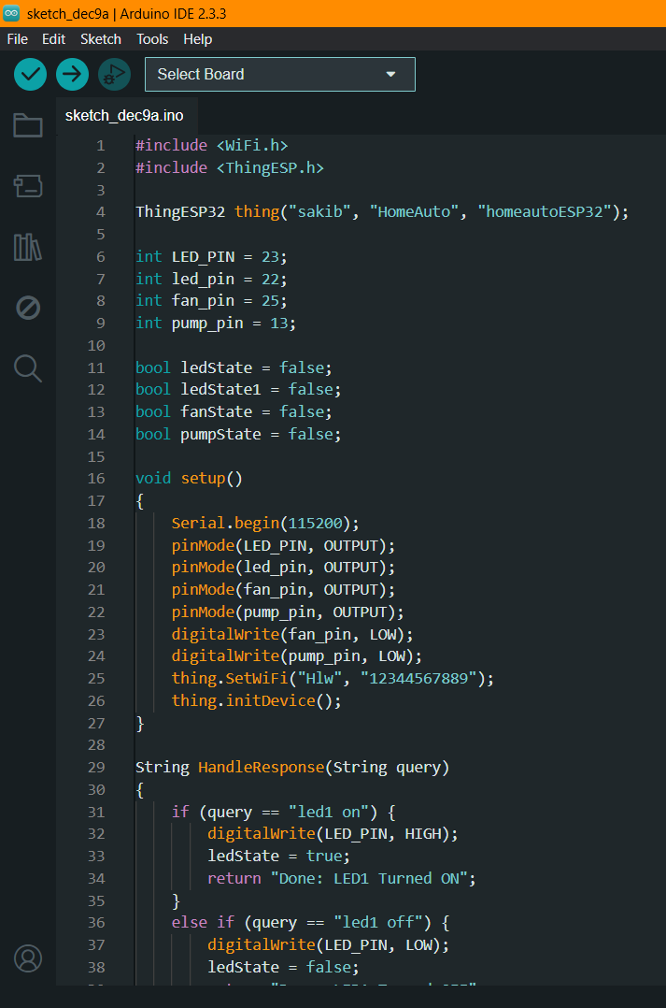
8
SOFTWARE IMPLEMENTATION
Arduino IDE

Slide 11
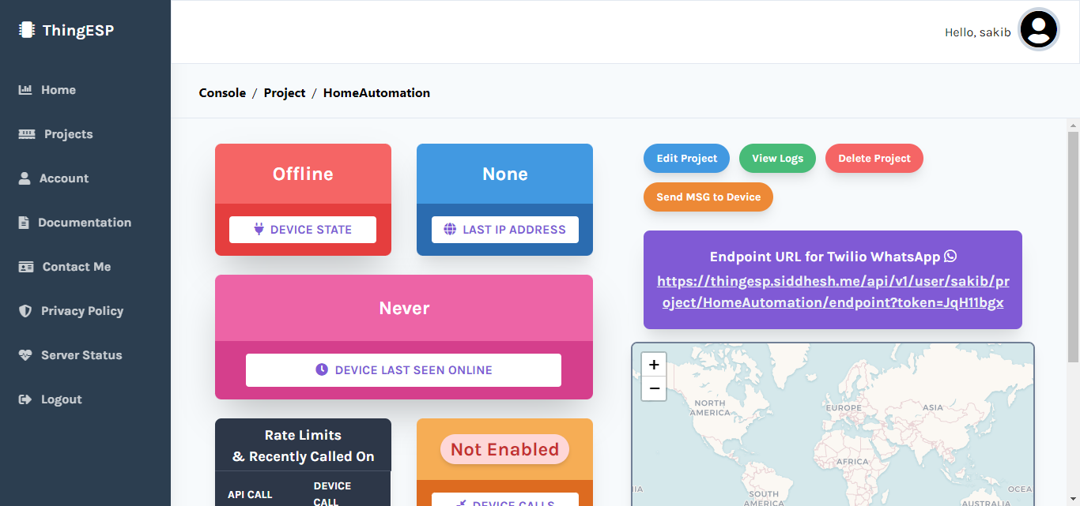
9
SOFTWARE IMPLEMENTATION
ThingESP

Slide 12
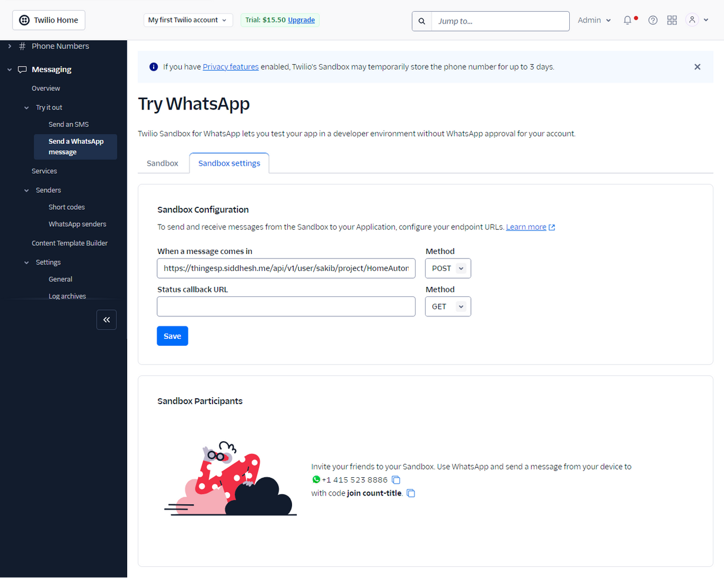
10
SOFTWARE IMPLEMENTATION
Twilio

Slide 13
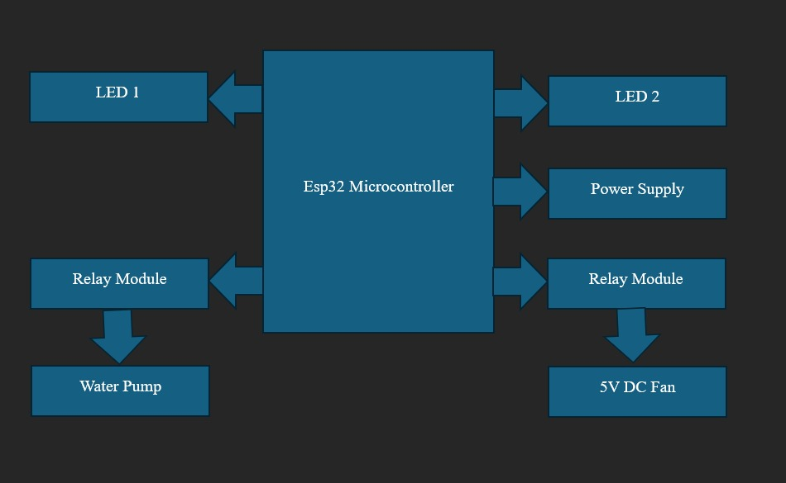
11
HARDWARE IMPLEMENTATION

Slide 14
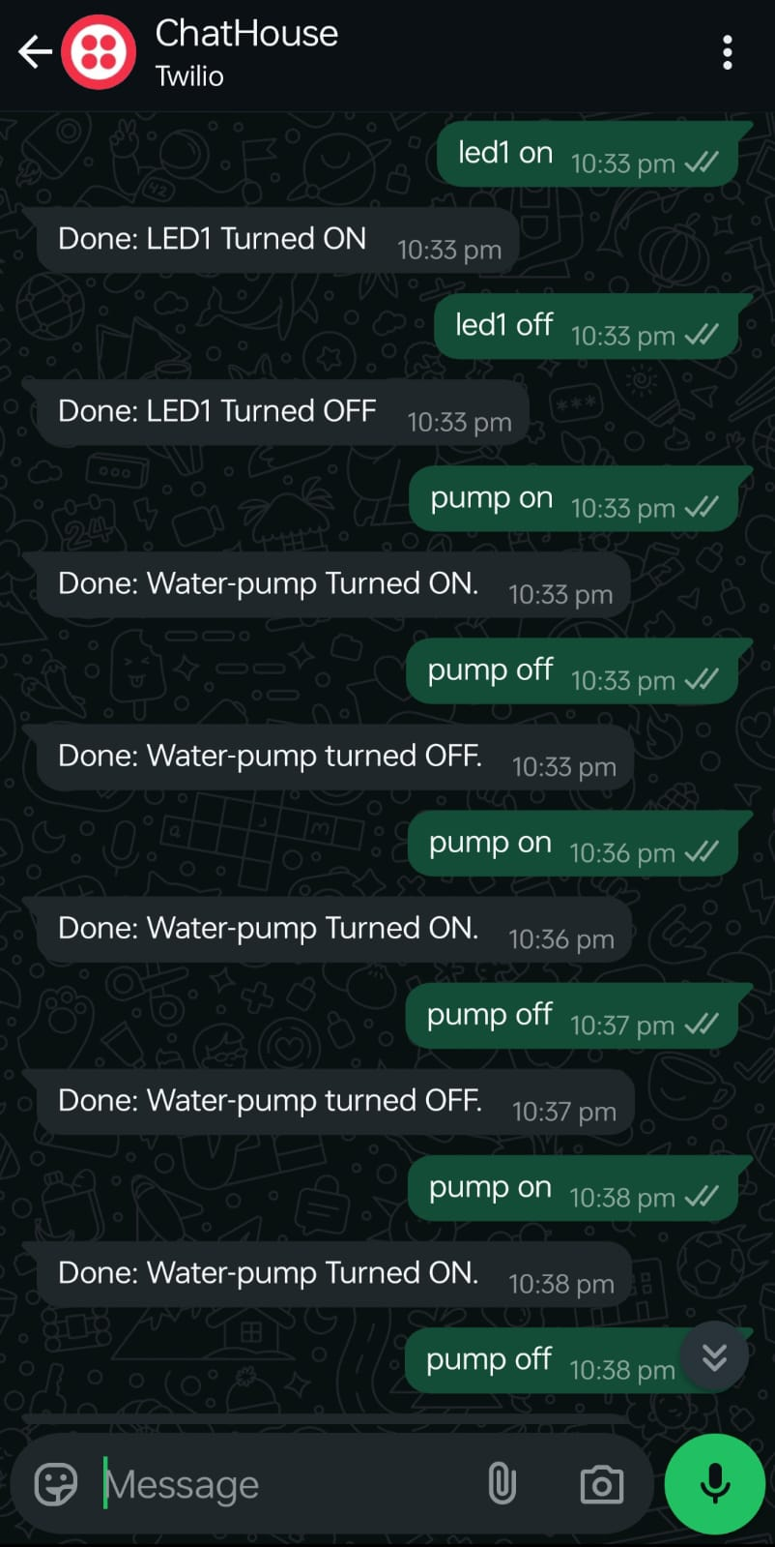
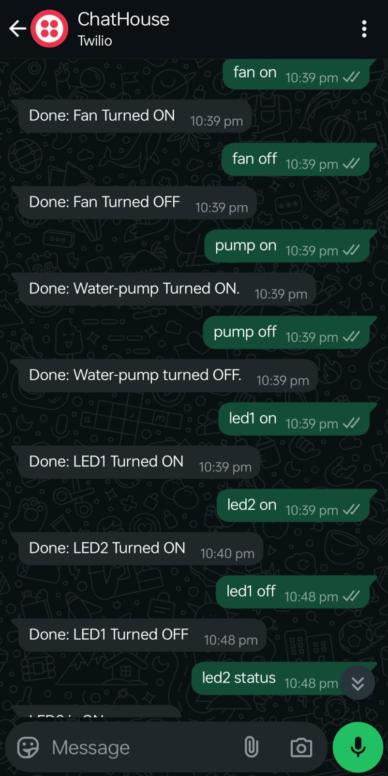
12
FINAL OUTCOME

Slide 15
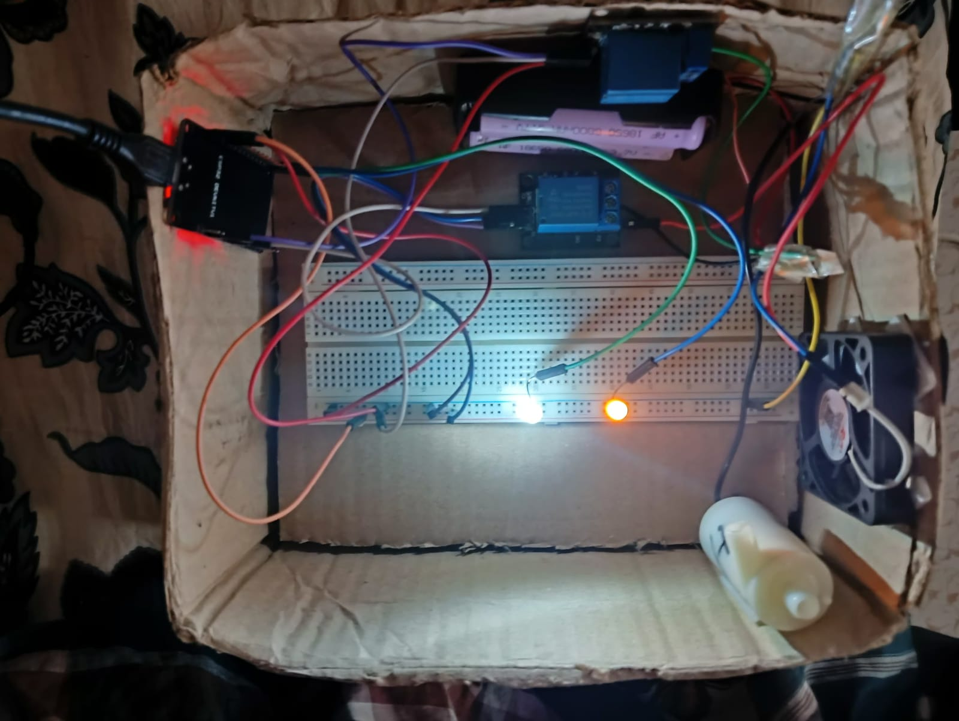
13
FINAL OUTCOME

Slide 16
14
CHALLENGES & LIMITATIONS
Wi-Fi Connectivity
Ensuring stable and reliable Wi-Fi connectivity for the ESP32.
API Integration
Proper integration of the WhatsApp API to ensure timely
and accurate communication.
Limitations
It only works on Local Network.

Slide 17
15
FUTURE WORK
Now our project is connected only the local network. So, in future we will work on to connect it with global network

Slide 18
16
CONCLUSION
ChatHouse aims to demonstrate the practical application of IoT in everyday life by developing a home automation system controlled via WhatsApp. By combining the ESP32's capabilities with the widespread use of WhatsApp, the project will showcase a simple yet powerful way to enhance controlling home appliances.

Slide 19
17
REFFERENCES
http://esp32.net
https://lastminuteengineers.com/electronics/esp32-projects/
https://docs.arduino.cc/software/ide/
https://thingesp.siddhesh.me/#/
https://www.twilio.com/en-us

Slide 20
THANK YOU

